Slide 1
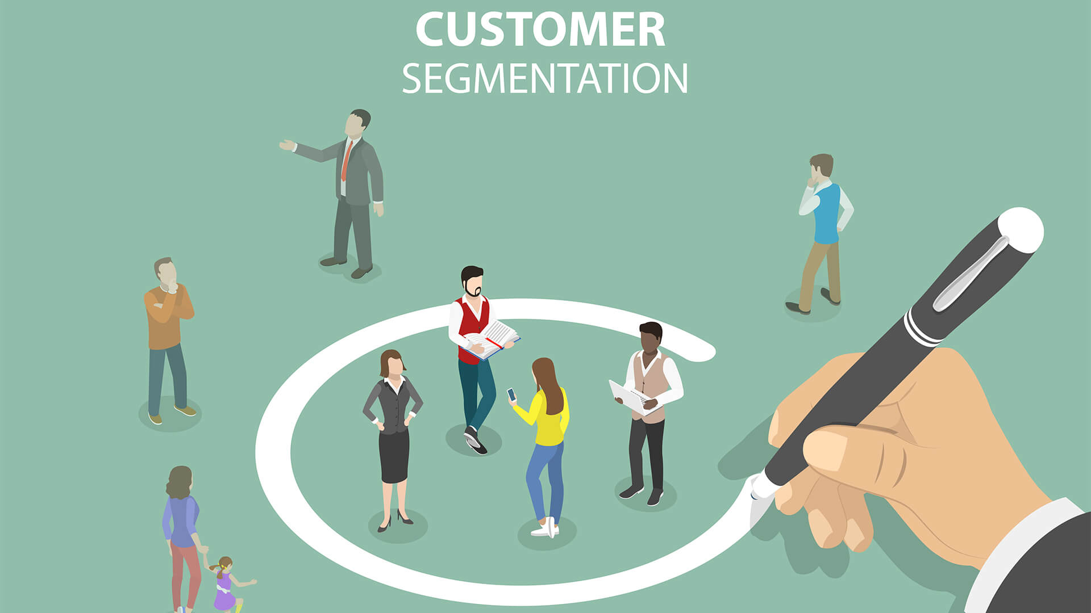

Project Name: Customer Segmentation (P – 521)

Slide 2
CONTENT
Introduction
Overview of Dataset
EDA
Data Visualization
Data Preprocessing
Model Building
Model Selection
Accuracy’s
Selecting a Suitable Model
Deployment
Conclusion

Slide 3
Introduction
Business Objective:
Customer personality analysis helps a business to modify its product based on its targetcustomers from different types of customer segments. Finding the potential customers by analysing the behaviour of them is useful to understand the targeted customers. For example, instead of spending money to market a new product to every customer in the company’s database, a company can analyse which customer segment is most likely to buy the product and then market the product only on that particular segment.

Slide 4
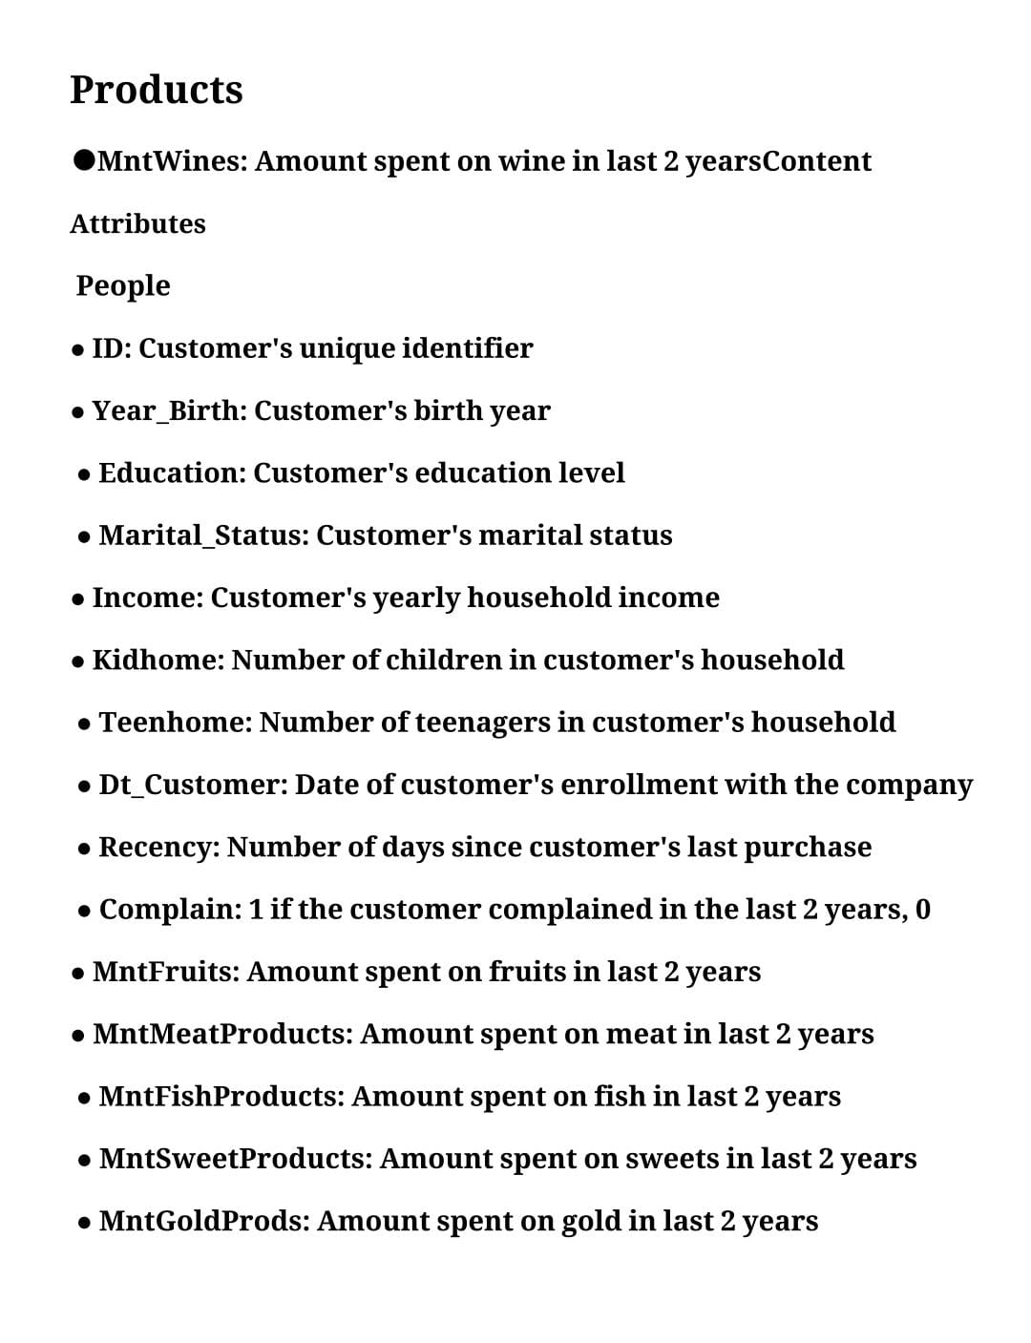
DATASET DETAILS:

Slide 5
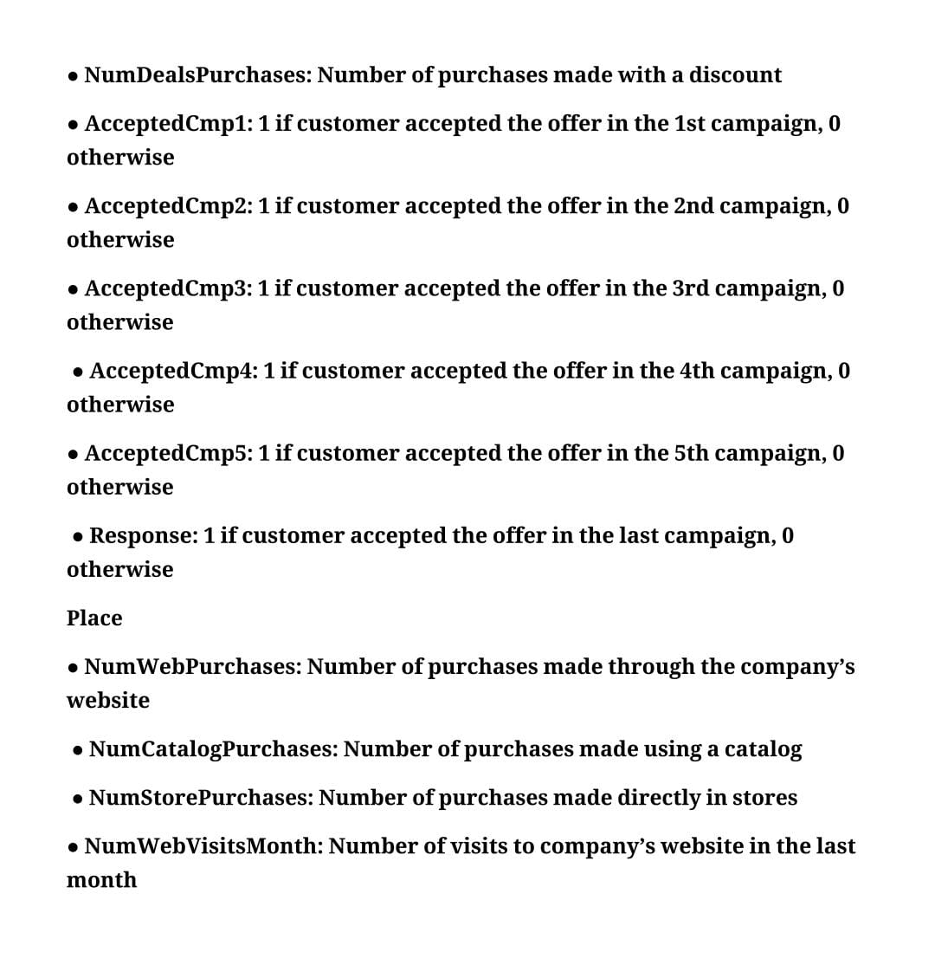

Slide 6


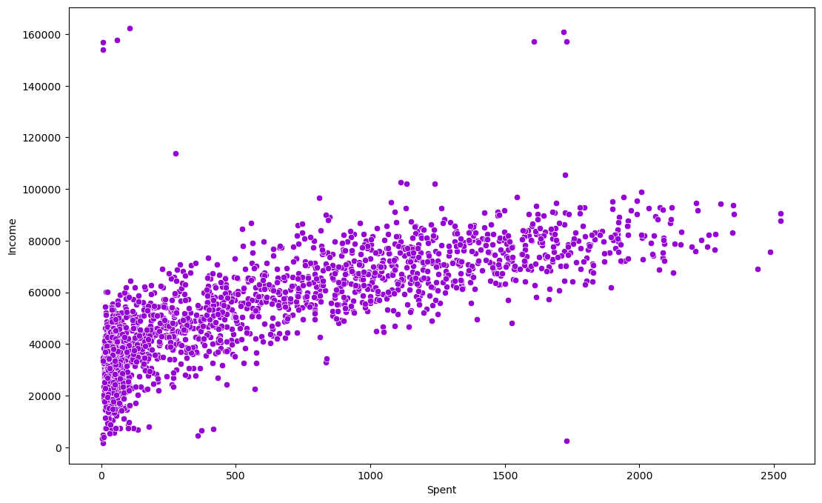
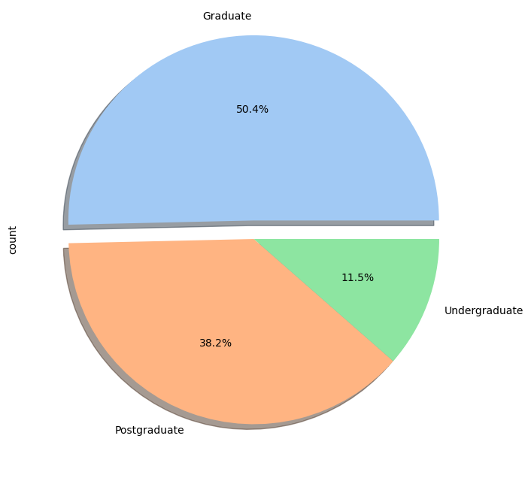
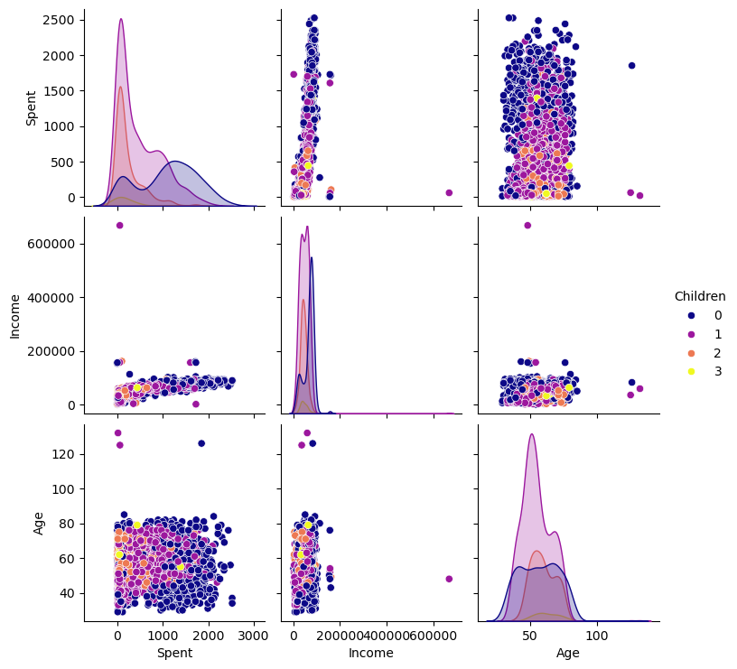

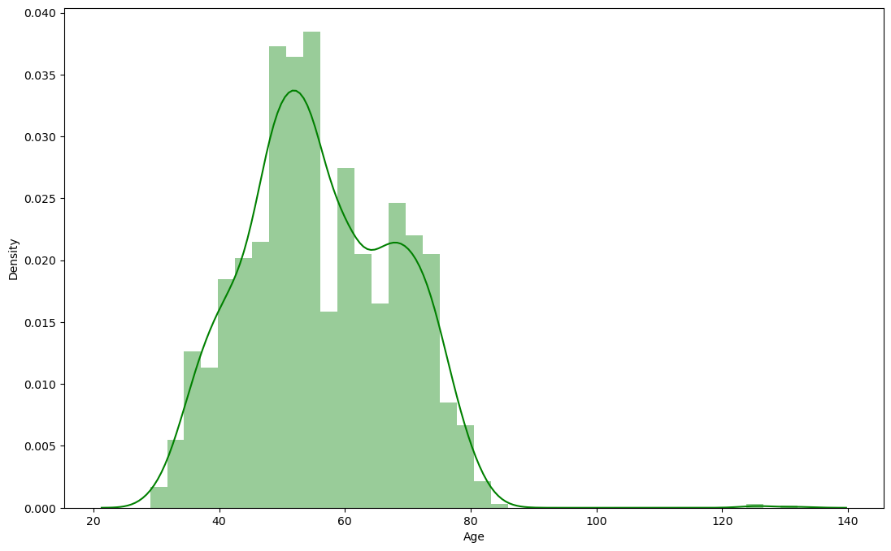


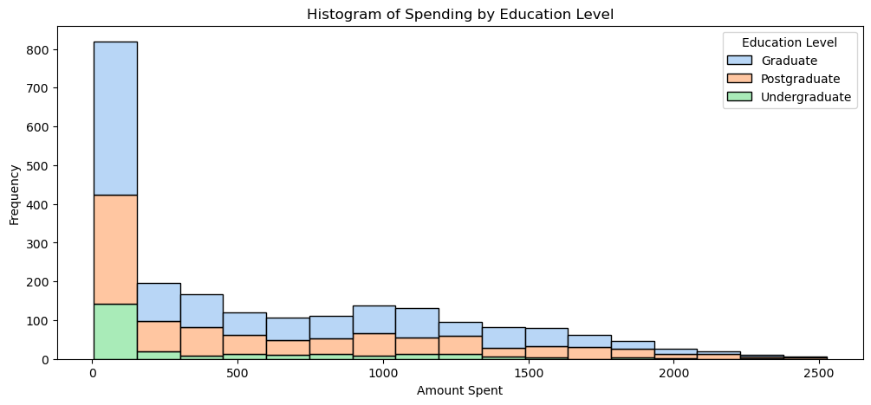
Data Visualization

Slide 7
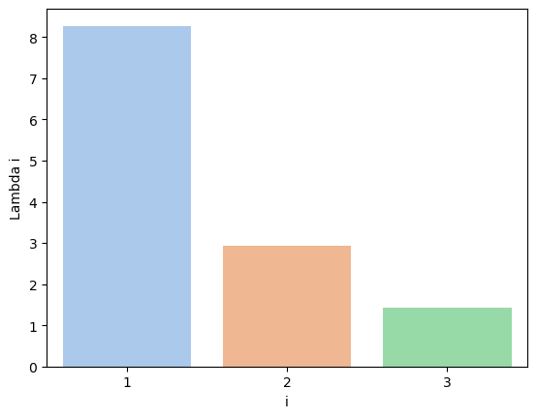
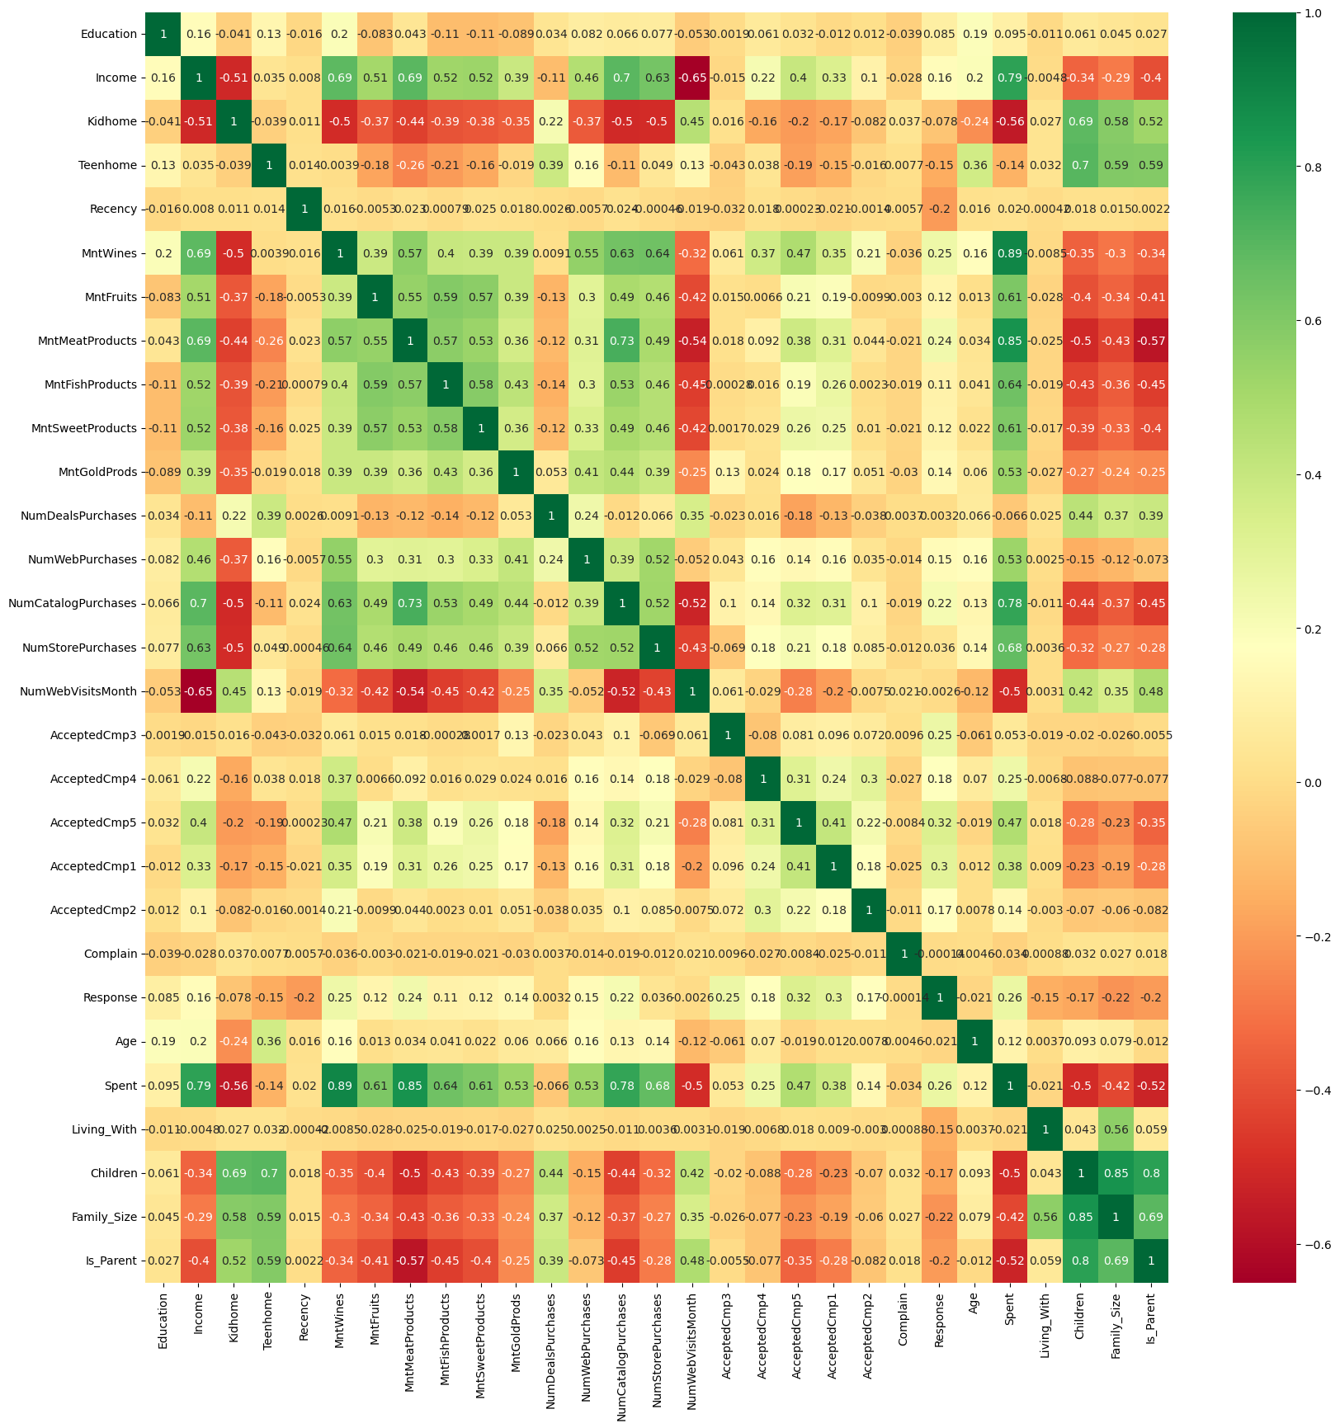



Slide 8
Data preprocessing
Missing Values: We handled missing values in the Income column by filling them with the median to reduce bias caused by outliers. This ensures the dataset remains complete and reliable for analysis.
Normalization/Scaling: We applied StandardScaler to bring all features to a common scale. This step is crucial for clustering models like K-Means, which are sensitive to feature magnitude.
Outliers Removal:Outliers in Income were removed using the IQR method to reduce noise and skewness. This helped in achieving more balanced and meaningful clusters
Deleting useless Features:We dropped irrelevant columns such as Z_CostContact, Z_Revenue, and IDs which didn’t contribute to customer behavior analysis. Removing them streamlined the model and improved focus on impactful features.

Slide 9
MODEL BUILDING
Feature Selection - Chose relevant numerical features such as Income, Age, and product-wise spending for clustering.
Standardization - Used StandardScaler to normalize the feature space, ensuring fair distance calculation in clustering.
Dimensionality Check - Ensured the selected features were not highly correlated to avoid redundancy in clustering.
Optimal K Selection - Used the Elbow Method and Silhouette Score to determine the optimal number of clusters (K=2).
Applying K-Means - Implemented K-Means clustering to segment customers into distinct behavioral groups.
Cluster Labeling - Assigned cluster labels to each customer and added them as a new column in the dataset.
Cluster Profiling - Analyzed each cluster based on average income, spending habits, and demographics.
Visualization Used boxplots and scatter plots to interpret the characteristics of each cluster visually.
Interpretation of Results - Identified patterns such as high spenders, price-sensitive customers, and potential growth segments.
Preparation for Deployment - Prepared the final data with cluster labels for use in targeted marketing strategies and app integration.

Slide 10
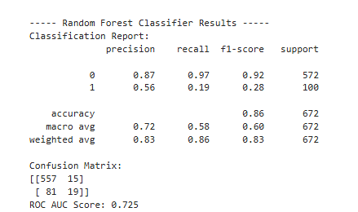
Model Selection: Model is selected based on the accuracy’s that we are gained with respective models and all ML Supervised Classification model are trained, tested and finally evaluated based on this evaluation final model is selected.
Model Accuracy’s
Selecting a Suitable Model: We all found that Random Forest which is an Ensemble model doing well in both Testing and Training as well as in prediction.

Slide 11
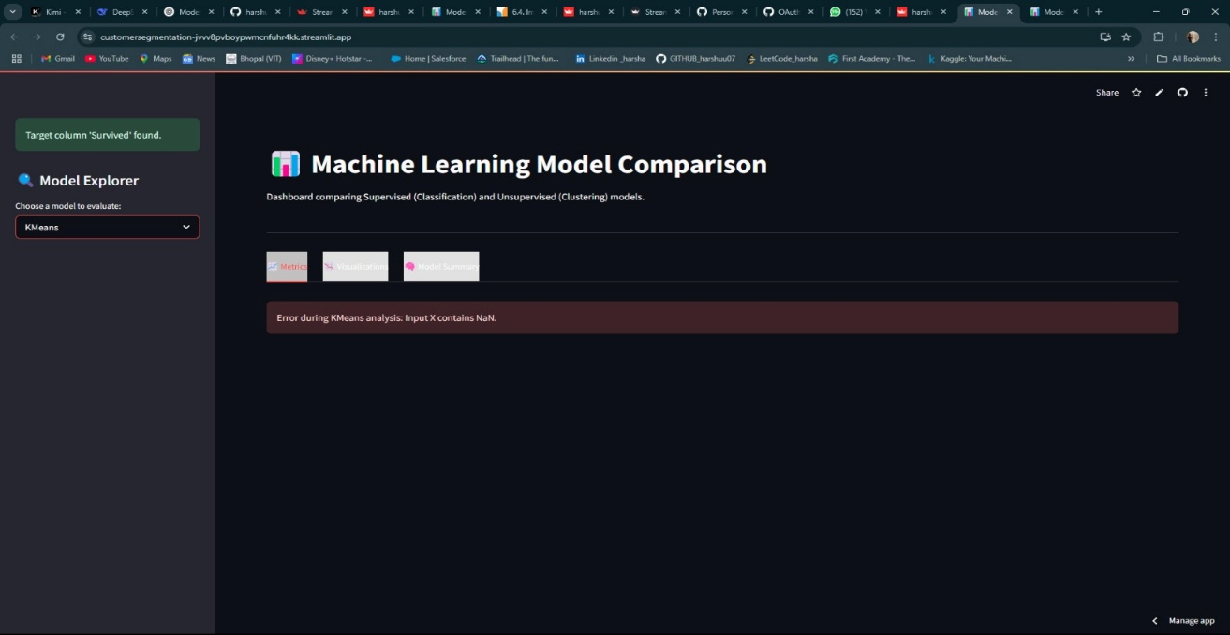
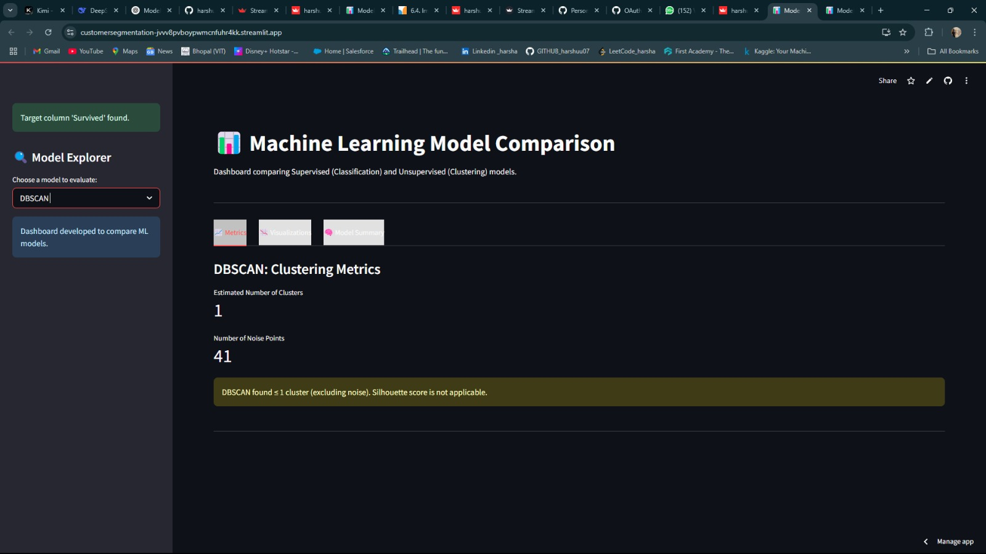
Deployment of Model
Build ML model is converted into Pickle file and then Model is Deployed through stream lit Application for client easiness.
The Input need to be given in and Output displays on screen either Attorney is involved or not.
insure.py is the deployment file and Here are the Reference Interfaces of model which are deployed.

Slide 12
Conclusion:
Data Preparation: Successfully cleaned and prepared the data, handling missing values and outliers effectively.
Feature Engineering: Created meaningful features like Age and Total_Spending to enhance insights.
Customer Segmentation: Segmented customers into 4 groups using K-Means, enabling targeted marketing strategies.
Model Validation: Validated the segmentation using Agglomerative Clustering, DBSCAN, and Gaussian Mixture Models.
Predictive Analysis: Built a Random Forest model to predict high-value customers.
Insights for Marketing: Analysis provides actionable insights to design smarter marketing campaigns and future personalization strategies.
Future Work: Focus on refining segmentation with behavioral data and advancing predictive modeling for more precise targeting.

Slide 13
Thank you

